Slide 1
Announcements
Complete lists of all required elements for the Pease Replication Notebook and Li Replication Notebook are posted in Dropbox>Labs>Replications.
MIDUS proposals are due at 11:59 PM, 11/27/17. One person from each group email the proposal to Kim.
No more quizzes for the semester!

Slide 2
Moderation Review
11/17/2017

Slide 3
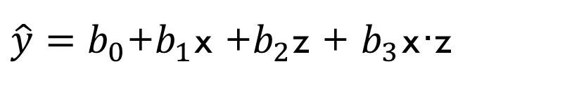
What is a Moderation Model?
Moderation models help us to determine if the effect of x on y depends on z. In other words, does the effect of x on y vary as a function of z?
For example, we can determine if the effect of a training program (x) on knowledge gained (y) is more beneficial for men compared to women (i.e., gender, z, moderates the effect of the training program).
Sex
Training
Knowledge
$\hat{y}=b_{0}$+$b_{1}$x +$b_{2}$z + $b_{3}$x·z
product term

Slide 4
Moderation/Interaction Graph
Women
Knowledge
Men
Control
Intervention
Training Program Condition

Slide 5
Moderation Equation
b₀ = predicted value of y when all predictors are 0
b₁ = predicted change in y for a one unit increase in xcen when zcen=0
b₂ = predicted change in y for a one unit increase in zcen when xcen=0
b₃ = predicted difference in the effect of xcen on y (b₁) for a one unit increase in zcen
Therefore:
b₁ is the effect of xcen on y when zcen = 0,
b₁ + (b₃ • 1) is the effect of xcen on y when zcen = +1
b₁ + (b₃ • -1) is the effect of xcen on y when zcen = -1

Slide 6
Interaction of 1 Categorical and 1 Continuous Variable

Slide 7
Inequality in Opportunity for Educational Attainment
Let’s explore potential inequalities in opportunities for educational attainment as a function of race/ ethnicity.
The National Longitudinal Study of Youth (NLSY)
longitudinal study of youth development funded by the Bureau of Labor Statistics. We’ll use a subset of the data (4,039 Black, Hispanic, and White participants who were 28 to 30 years old in 2010)

Slide 8
Variables
1. race: Black, Hispanic, White
2. sex: male, female
3. yrseduc: # of years of education completed by 2010
4. stdtest: normed percentile score based on math and verbal standardized tests

Slide 9
Research Question
Is the effect of standardized test scores on years of education different for individuals with different Race/Ethnicity?

Slide 10
Research Question
We will now assess the potential interaction between race/ethnicity and standardized test scores. This will allow us to determine if the effect of standardized test scores on completed years of education varies as a function of race/ethnicity.
Race/Ethnicity
Test Score
Yrs. of Education

Slide 11
Preparing Data- dummy codes
Race/ethnicity dummy codes:
In all of the following examples, we will consider NH White individuals as the reference group and we will only compare Black individuals to NH White individuals and Hispanic individuals to NH White individuals (we will not compare Black individuals to Hispanic individuals). However by switching the reference group and applying a correction for the family wise error rate, this would be easily accomplished.
Dummy Variable: | White | Black/African America | Hispanic
BLACK | 0 | 1 | 0
HISPANIC | 0 | 0 | 1
Notes:
Remember, with dummy variable you can only compare to the refrence group. We can’t compare black and Hispanic!.. Unless you switch around your comparison category.

Slide 12
Preparing Data- Mean Centering
We want to mean center our continuous predictor (Std test score), so that it has a meaningful zero point.
mutate(stdtest_m = stdtest – mean(stdtest))

Slide 13
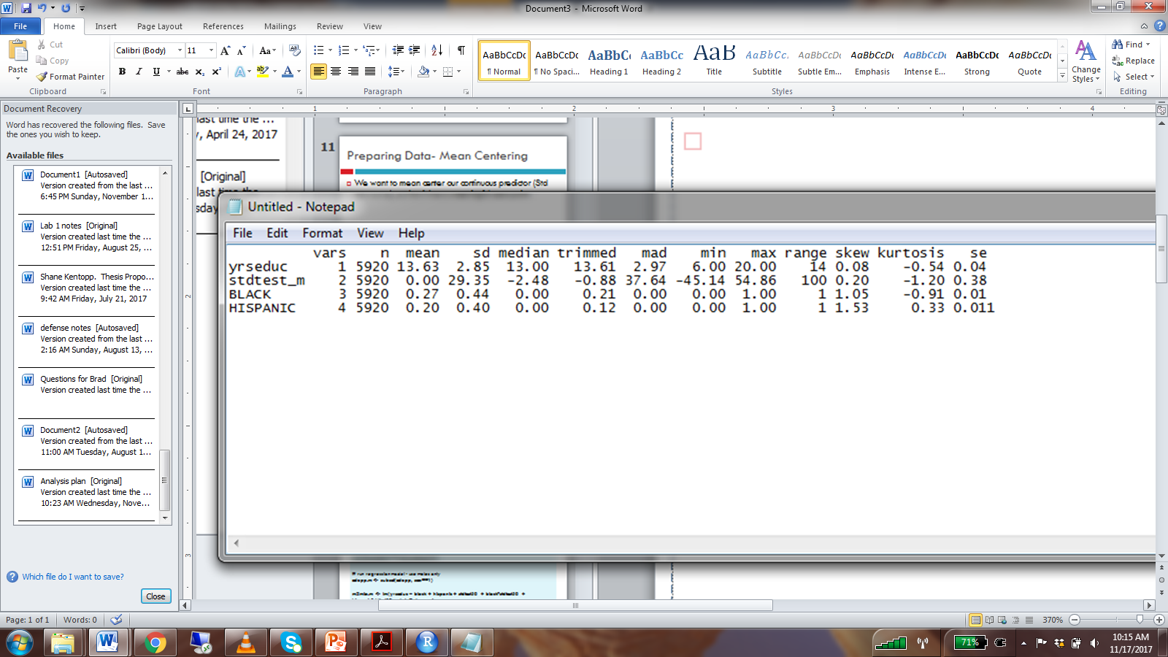
Descriptives

Slide 14
Run Moderation Model
We are interested in the interaction between race and test score. But, we had to dummy code race because it’s a factor.
Instead of 1 race variable, we now have 2 dummy coded variables.
We must include 2 interaction terms in the model: multiplying stdtest_m by each of the race dummy codes.
modmodel <- lm(yrseduc ~ black + hispanic + stdtest_m + black*stdtest_m + hispanic*stdtest_m, data=edopp.m)
ols_regress(modmodel)

Slide 15
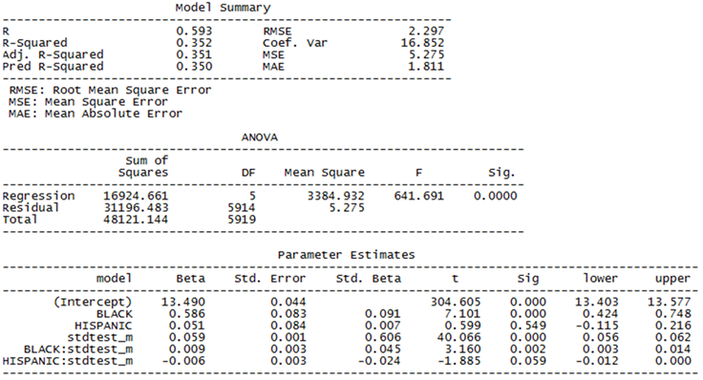
Model Results

Slide 16
Model Results- intercept
The intercept is the predicted years of education for White participants with an average standardized test score. (i.e. BLACK = 0, HISPANIC = 0, stdtest_m = 0)

Slide 17
Model Results- simple slope
Simple slope: the effect of one predictor at a certain level of another predictor
Example:
Y = B0 + B1(X) + B2(M) + B3(X)(M)
B1 is always the simple slope for X when M = 0.
Assigning M = 0 cancels out the interaction term.
Y = B0 + B1(X) + B2(0) + B3(X)(0)
Y = B0 + B1(X) + 0 + 0

Slide 18
Model Results- simple slope
We can find the simple slope for X when M is not 0, but it is no longer equal to B1.
If M != 0, then the interaction term is not cancelled out, and it changes the effect of X on Y.
Example: M = 1
Y = B0 + B1(X) + B2(M) + B3(X)(M)
Y = B0 + B1(X) + B2(1) + B3(X)(1)
Y = B0 + B2(1) + B1(X) + B3(X)
Y = (B0 + B2) + (B1 + B3)(X)

Slide 19
Model Results- Simple Slope BLACK
The beta for black is the predicted difference in the average years of education between Black and White individuals who have an average standardized test score (i.e. stdtest_m = 0). This difference is statistically significant.

Slide 20
Model Results- Simple Slope BLACK
HISPANIC = 0 because we’re only looking at black individuals compared to white individuals
Stdtest_m = 0 so that the interaction term will cancel out
Y = 13.49 + 0.586(BLACK) + 0.051(HISPANIC) + 0.059(stdtest_m) + 0.009(BLACK)(stdtest_m) + -.006(HISPANIC)(stdtest_m)
Y = 13.49 + 0.586(BLACK) + 0.051(0) + 0.059(0) + 0.009(BLACK)(0) + -.006(0)(0)
Y = 13.49 + 0.586(BLACK)
The beta for black is the predicted difference in the years of education between Black males and White with an average standardized test score (i.e. stdtest_m = 0). This difference is statistically significant.

Slide 21
Model Results- Simple Slope HISPANIC
The slope for hispanic is the predicted difference in average years of education between Hispanic and White individuals with an average standardized test score. (i.e. stdtest_m = 0) This difference is not statistically significant.

Slide 22
Model Results- Simple Slope HISPANIC
BLACK = 0 because we’re only looking at hispanic individuals compared to white individuals
Stdtest_m = 0 so that the interaction term will cancel out
Y = 13.49 + 0.586(BLACK) + 0.051(HISPANIC) + 0.059(stdtest_m) + 0.009(BLACK)(stdtest_m) + -.006(HISPANIC)(stdtest_m)
Y = 13.49 + 0.586(0) + 0.051(HISPANIC) + 0.059(0) + 0.009(0)(0) +
-.006(HISPANIC)(0)
Y = 13.49 + 0.051(HISPANIC)
The slope for hispanic is the predicted difference in years of education between Hispanic and White individuals with an average standardized test score. (i.e. stdtest_m = 0) This difference is not statistically significant.

Slide 23
Model Results- Simple Slope stdtest_m
The slope for stdtest_m is the predicted increase in years of education for a one unit increase in standardized test score among White males. (i.e. BLACK = 0, HISPANIC = 0) This effect is statistically significant.

Slide 24
Model Results- Simple Slope stdtest_m
Stdtest_m is part of two interaction terms, so we have to set BLACK and HISPANIC = 0 to cancel both out in order to interpret the beta for stdtest_m
Y = 13.49 + 0.586(BLACK) + 0.051(HISPANIC) + 0.059(stdtest_m) + 0.009(BLACK)(stdtest_m) + -.006(HISPANIC)(stdtest_m)
Y = 13.49 + 0.586(0) + 0.051(0) + 0.059(stdtest_m) + 0.009(0)(stdtest_m) +
-.006(0)(stdtest_m)
Y = 13.49 + 0.059(stdtest_m)
The slope for stdtest_m is the predicted increase in years of education for a one unit increase in standardized test score among White males. (i.e. BLACK = 0, HISPANIC = 0) This effect is statistically significant.

Slide 25
Model Results- Interaction BLACK
The black*stdtest_m interaction term is the predicted difference in the effect of test score for Black compared to White individuals. The interaction term is statistically significant, indicating that the effect of test scores on years of education differs between Black and White individuals.
Notes:
The interaction terms are telling us about the changes of effect on y

Slide 26
Model Results- Interaction BLACK
Y = 13.49 + 0.586(BLACK) + 0.051(HISPANIC) + 0.059(stdtest_m) + 0.009(BLACK)(stdtest_m) + -.006(HISPANIC)(stdtest_m)
Effect of stdtest_m for black individuals:
Y = 13.49 + 0.586(1) + 0.051(0) + 0.059(stdtest_m) + 0.009(1)(stdtest_m) +
-.006(0)(stdtest_m)
Y = 14.076 + 0.059(stdtest_m) + 0.009(stdtest_m)
Y = 14.076 + .068(stdtest_m)
Effect of ststest_m for white individuals
Y = 13.49 + 0.586(0) + 0.051(0) + 0.059(stdtest_m) + 0.009(0)(stdtest_m) +
-.006(0)(stdtest_m)
Y = 13.49 + 0.059(stdtest_m)
Difference between the two effects:
0.068 - .059 = .009
The black*stdtest_m interaction term is the predicted difference in the effect of test score for Black compared to White individuals. The interaction term is statistically significant, indicating that the effect of test scores on years of education differs between Black and White individuals.
~ beta for the interaction term

Slide 27
Model Results- Interaction HISPANIC
The hispanic*stdtest_m interaction term is the predicted difference in the effect of test score for Hispanic compared to White individuals. The interaction term is not statistically significant, indicating that the effect of test scores on years of education doesn’t differ between Hispanic and White individuals.

Slide 28
Model Results- Interaction HISPANIC
Y = 13.49 + 0.586(BLACK) + 0.051(HISPANIC) + 0.059(stdtest_m) + 0.009(BLACK)(stdtest_m) + -.006(HISPANIC)(stdtest_m)
Effect of stdtest_m for hispanic individuals:
Y = 13.49 + 0.586(0) + 0.051(1) + 0.059(stdtest_m) + 0.009(0)(stdtest_m) +
-.006(1)(stdtest_m)
Y = 13.541 + 0.059(stdtest_m) + -0.006(stdtest_m)
Y = 14.076 + .053(stdtest_m)
Effect of ststest_m for white individuals
Y = 13.49 + 0.586(0) + 0.051(0) + 0.059(stdtest_m) + 0.009(0)(stdtest_m) +
-.006(0)(stdtest_m)
Y = 13.49 + 0.059(stdtest_m)
Difference between the two effects:
0.053 - .059 = -.006
The hispanic*stdtest_m interaction term is the predicted difference in the effect of test score for Hispanic compared to White individuals. The interaction term is not statistically significant, indicating that the effect of test scores on years of education doesn’t differ between Hispanic and White individuals.
~ beta for the interaction term

Slide 29
Control variables and moderation
We can run the same model controlling for age by adding age as a predictor.
Changes interpretation of beta estimates slightly.
modmodel2 <- lm(yrseduc ~ age + BLACK + HISPANIC + stdtest_m + BLACK*stdtest_m + HISPANIC*stdtest_m, data=edopp)

Slide 30
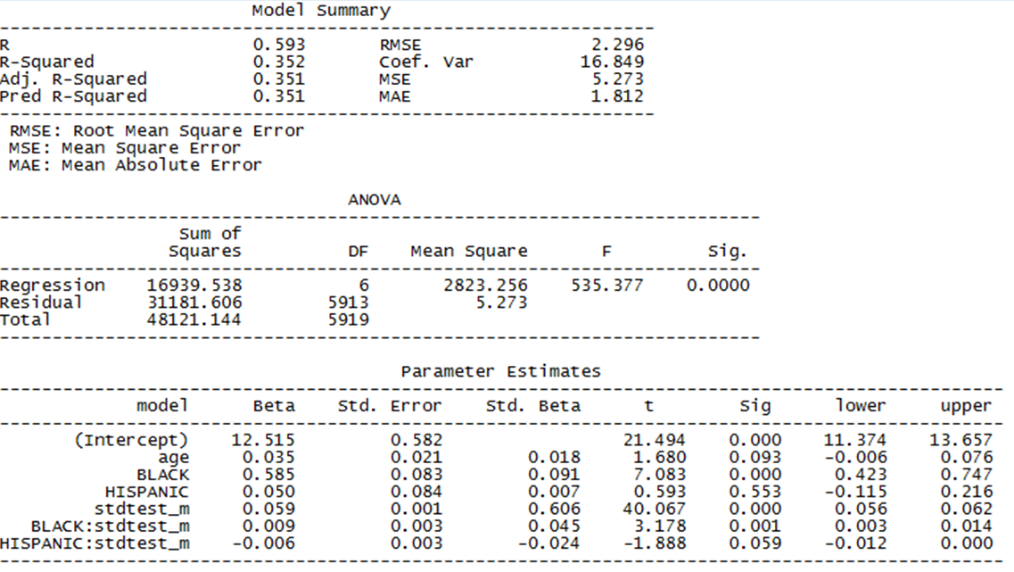
Model Results

Slide 31
Model Results- Simple Slope BLACK
The beta for black is the predicted difference in average years of education between Black and White individuals with an average standardized test score, holding age constant. This difference is statistically significant.
Notes:
Age is conditionally invariant in this model. Meaning that it is ALWAYS held constant because it is not part of the interaction term.

Slide 32
Control variables and moderation
Y = B0 + B1(X1) + B2(X2) + B3(M) + B4(X2)(M)
Control Variables:
NOT part of an interaction term.
When interpreting B2, we say “…while controlling for X1” or “…holding X1 constant”
The value of X1 can be anything, and it won’t change the effect of X2 or M.
Moderation Variables
ARE part of an interaction term
When interpreting B2, we must specify that M = 0.
i.e. “… when M is equal to zero”
If M has been mean centered, we say “… at the average of M”

Slide 33
Writing Reduced-form regression equations
Given the full model results, we can write the regression equation for any given combination of predictors.
E.g. what is the reduced equation relating stdtest_m to yrseduc for a 30 y/o Hispanic individual?
Plug in age = 30, HISPANIC = 1, BLACK = 0

Slide 34
What is the effect of stdtest_m on yrseduc for a 30 y/o Hispanic individual?
Y = 12.515 + 0.035(age) + 0.585(BLACK) + 0.050(HISPANIC) + 0.059(stdtest_m) + 0.009(BLACK)(stdtest_m) + (HISPANIC)(stdtest_m)-0.006
Y = 12.515 + 0.035(30) + 0.585(0) + 0.050(1) + 0.059(stdtest_m) + 0.009(0)(stdtest_m) + (1)(stdtest_m)-0.006
Y = 12.515 + 1.05 + 0.050 +0.059(stdtest_m) +
(stdtest_m)(-0.006)
Y = 13.605 + 0.053(stdtest_m)

Slide 35
Practice activity in dropbox folder

